Slide 1
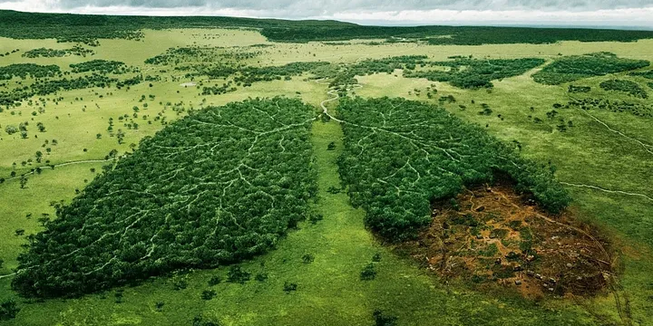

Global Air Quality
Southern Methodist University
Data Science Bootcamp
Project 3

Slide 2

Team 2 Members
Misha Borunda
Kimberly Childers
Jason Cisneros
Raheem Yusuff
Damarje Brown

Slide 3

Background
According to the World Health Organization, Air pollution is one of the greatest environmental risk to health that affects people from all different backgrounds
Outdoor air pollution in both cities and rural areas was estimated to cause 4.2 million premature deaths worldwide per year in 2019; this mortality is due to exposure to fine particulate matter, which causes cardiovascular and respiratory disease, and cancers
Addressing air pollution, which is the second highest risk factor for noncommunicable diseases, is key to protecting public health
Most sources of outdoor air pollution are well beyond the control of individuals and this demands concerted action by local, national and regional level policy-makers working in sectors like energy, transport, waste management, urban planning and agriculture.

Slide 4
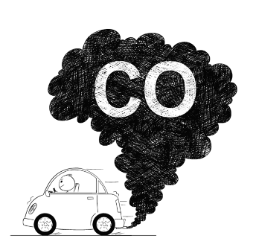
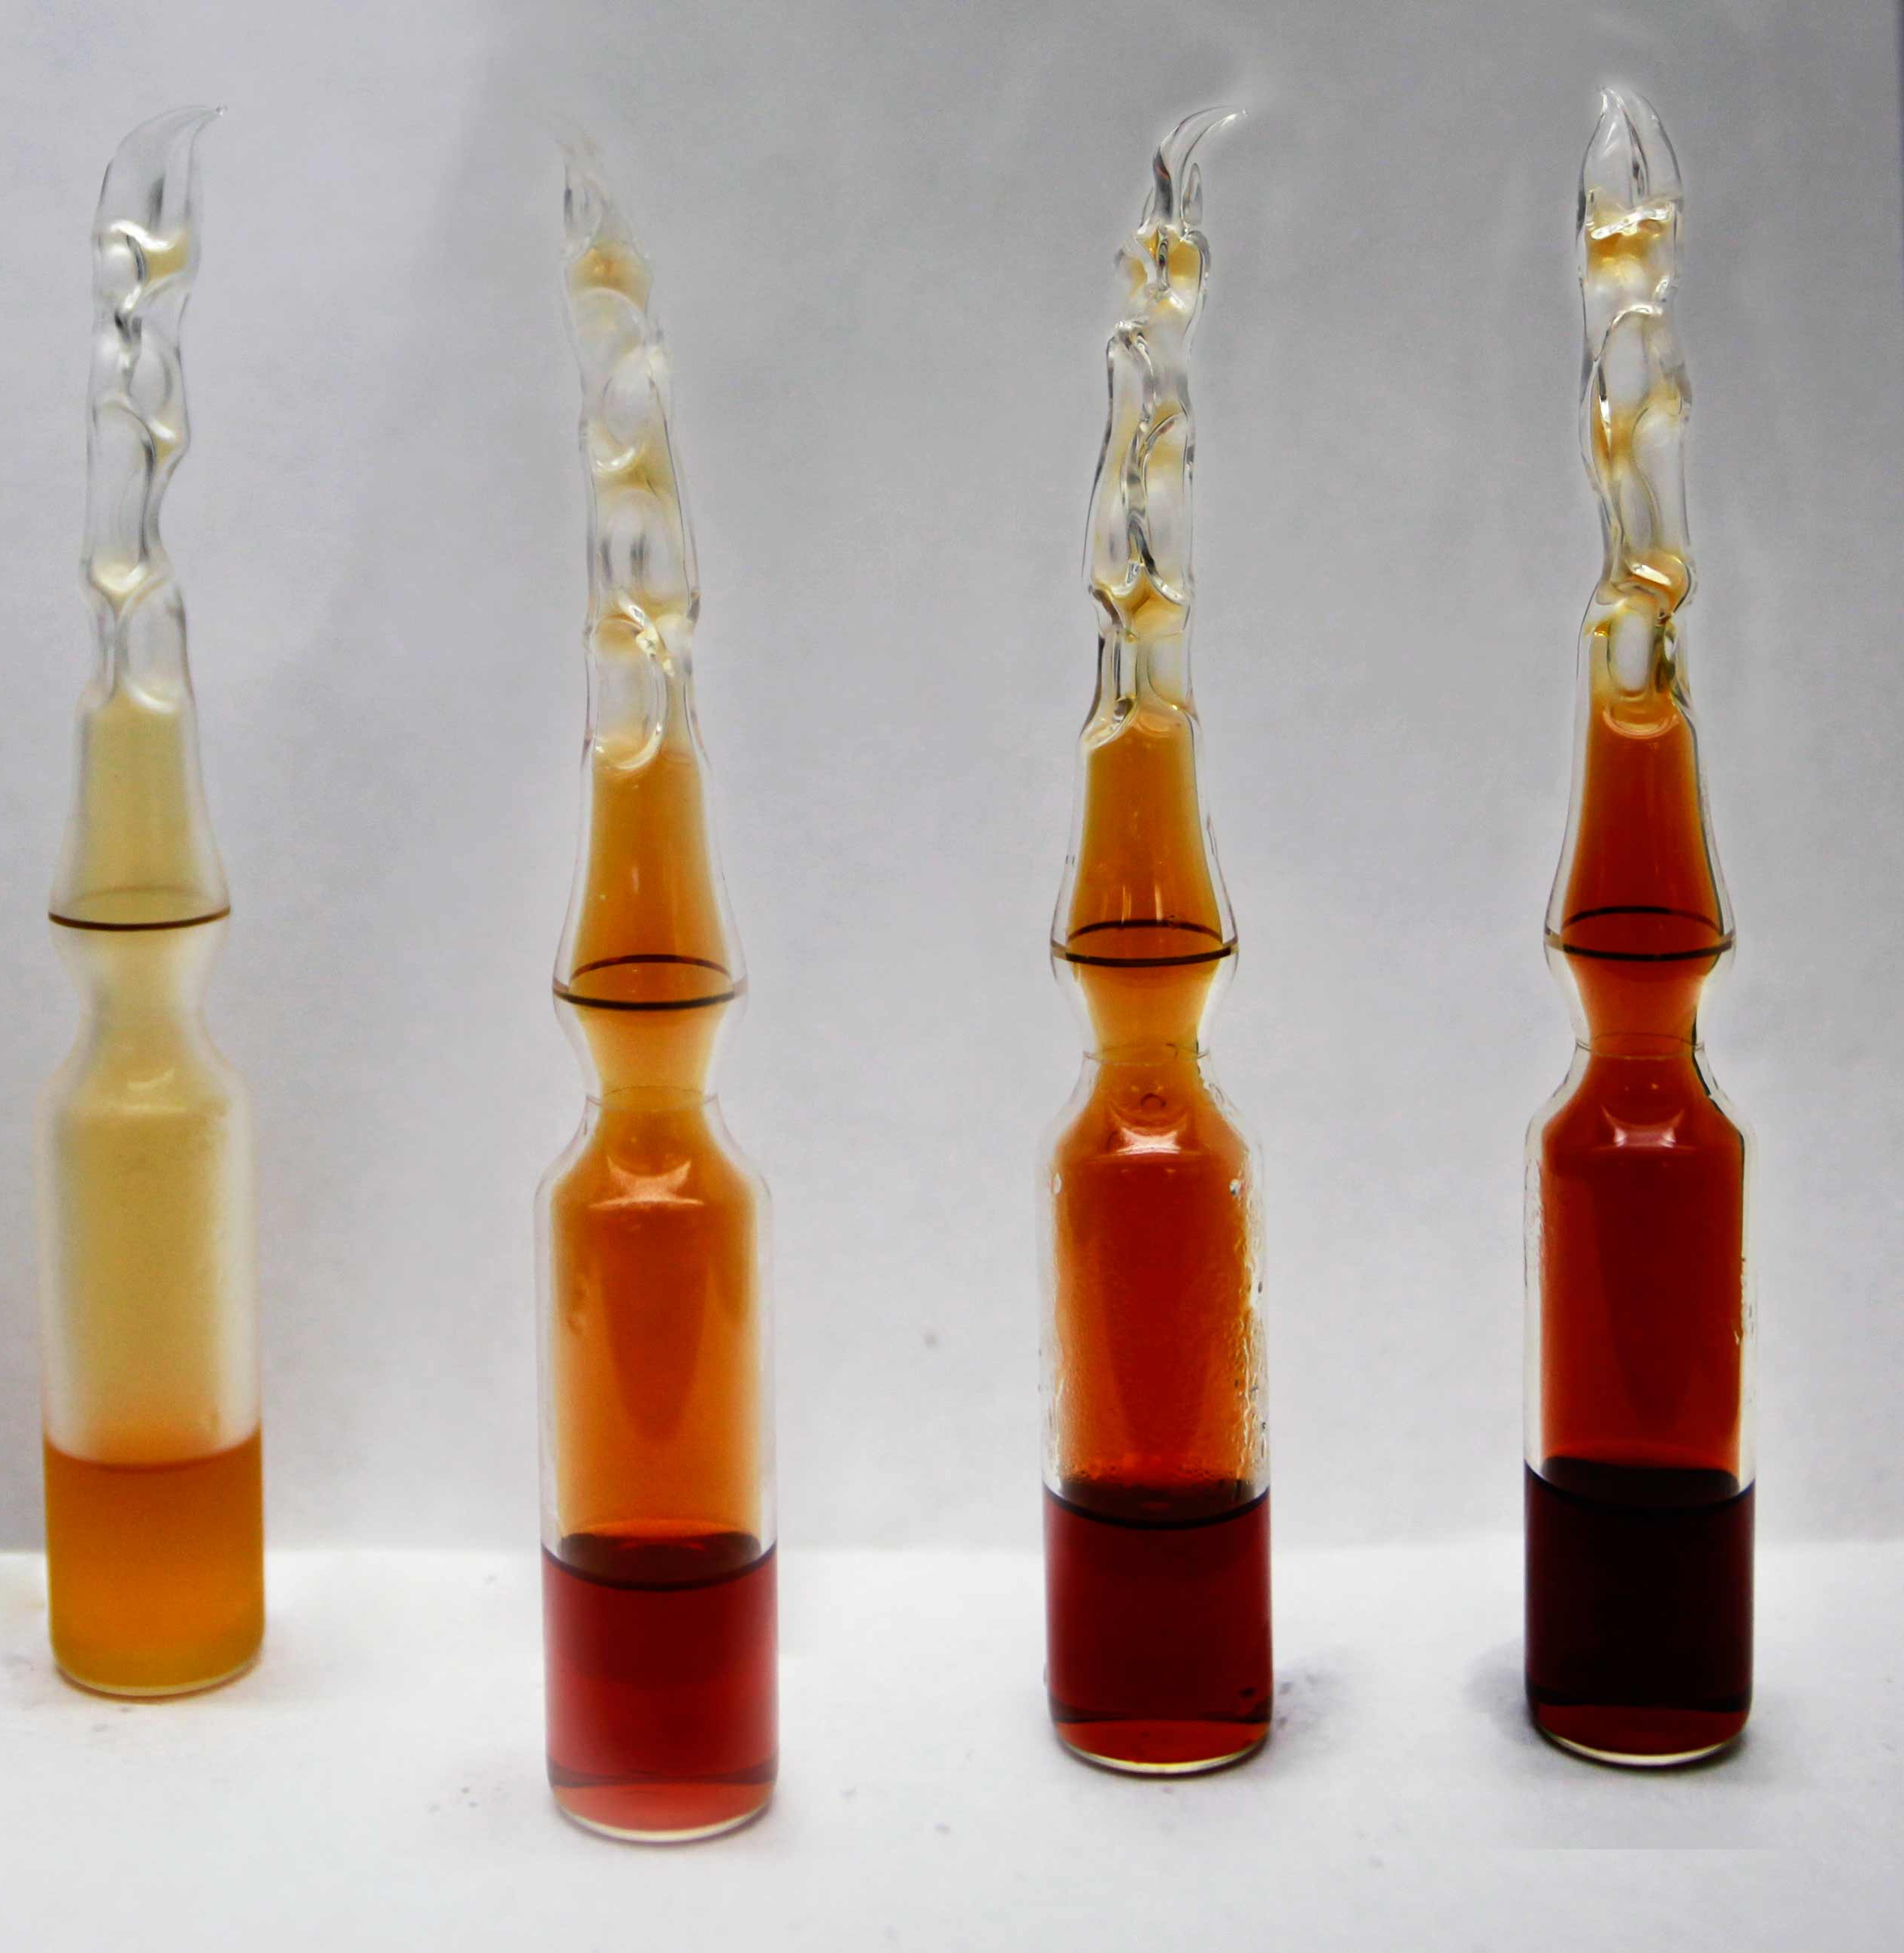
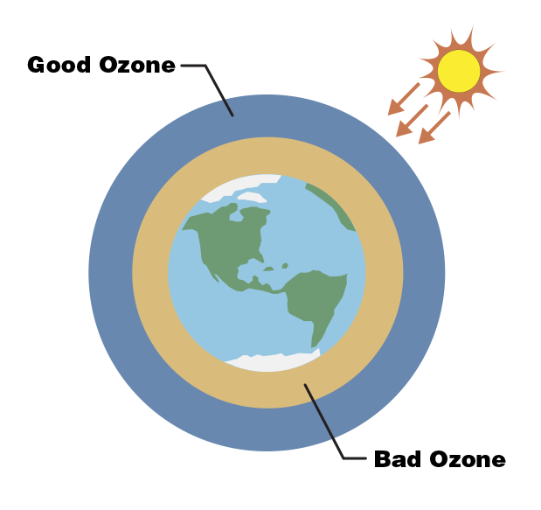
Technical Terminology
AQI Air Quality Index is used for reporting daily air quality. It tells you how clean or polluted your air is
Pollutants
Particulate matter (PM2.5) Fine Particulates such as sulfates, nitrates, ammonia, sodium chloride, black carbon, mineral dust and water.
Carbon monoxide (CO) Toxic gas produced by the incomplete combustion of carbonaceous fuels
Ozone (O₃) Ozone at ground level – not to be confused with the ozone layer in the upper atmosphere – is one of the major constituents of photochemical smog and it is formed through the reaction with gases in the presence of sunlight.
Nitrogen dioxide (NO₂) NO₂ is a gas that is commonly released from the combustion of fuels in the transportation and industrial sectors.

Slide 5
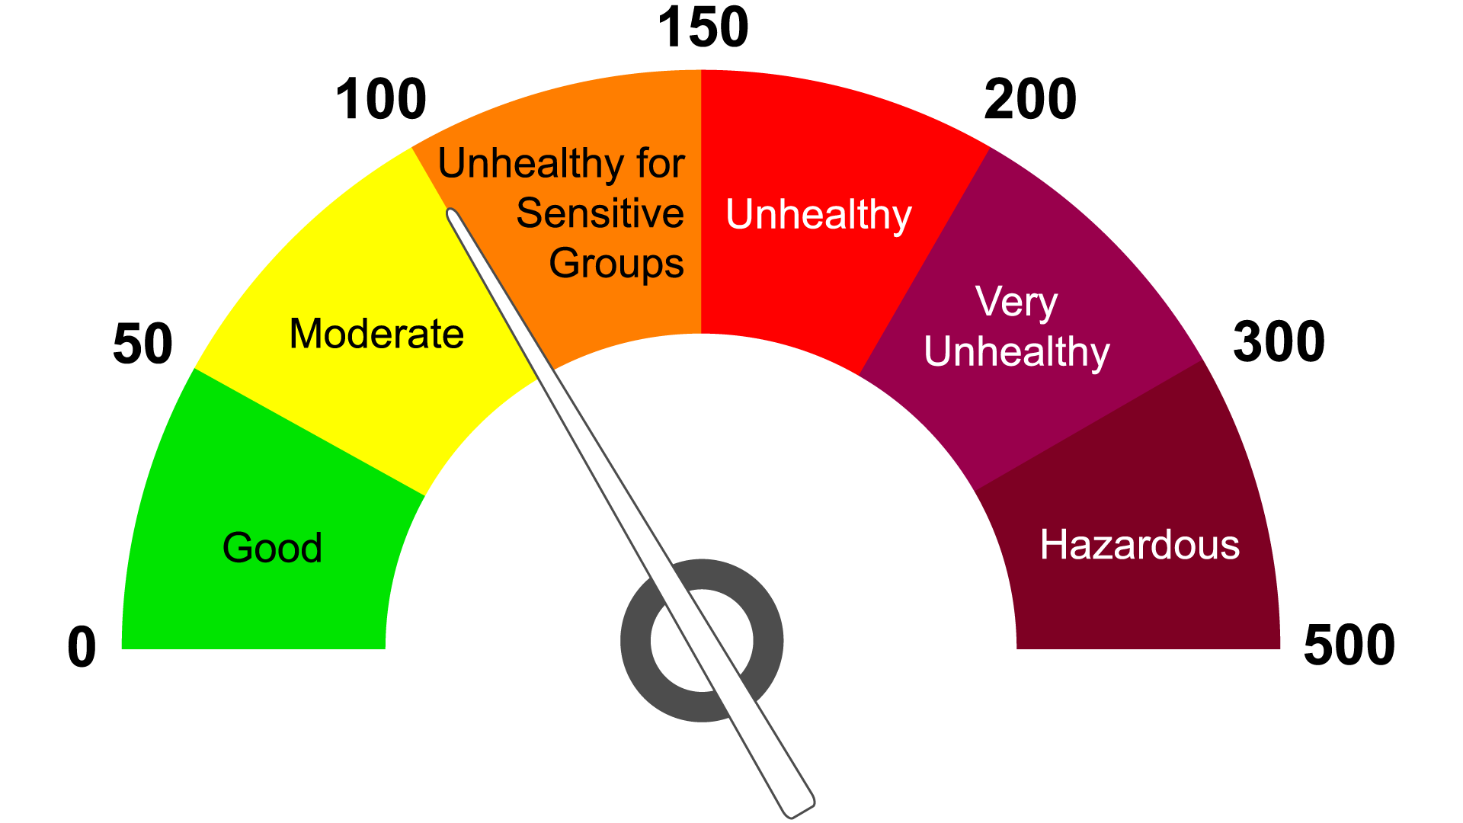
Air Quality Index

Slide 6
Data Set
 | Data Set Columns
1 | Country
2 | City
3 | AQI Value
4 | AQI Category
5 | CO AQI Value
6 | CO AQI Category
7 | Ozone AQI Value
8 | Ozone AQI Category
9 | NO2 AQI Value
10 | NO2 AQI Category
11 | PM2.5 AQI Value
12 | PM2.5 AQI Category
13 | lat
14 | lng
Overall Information
Total of 16,394 rows
Last updated 9 months ago
This dataset is a merger of two separate datasets, one containing information about cities and their corresponding latitude and longitude coordinates, and the other containing data on air pollution levels in countries across the world
Quality Challenges
This data set contains some latitude and longitude points that are wrong and do not correspond to the country or city they are supposed to be identifying.
Therefore, our analysis includes outliers
https://www.kaggle.com/datasets/adityaramachandran27/world-air-quality-index-by-city-and-coordinates

Slide 7
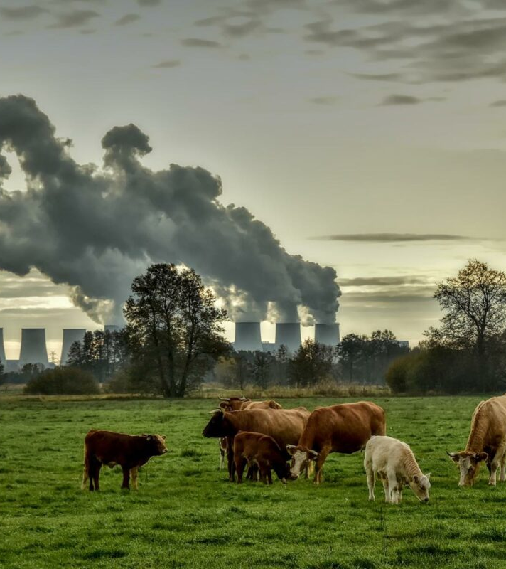
Research Questions
What are the top 10 countries with the best and worst Air Quality Index (AQI)?
What are the top 10 cities with the best and worst AQI?
Average AQI value per country?

Slide 8
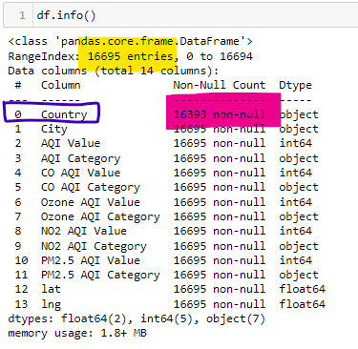

Data Prep and Clean Up
There were a total of 302 rows of data that did not have a Country associated with them and 2 null values.
These values were dropped from the data set in order to have more consistency

Slide 9
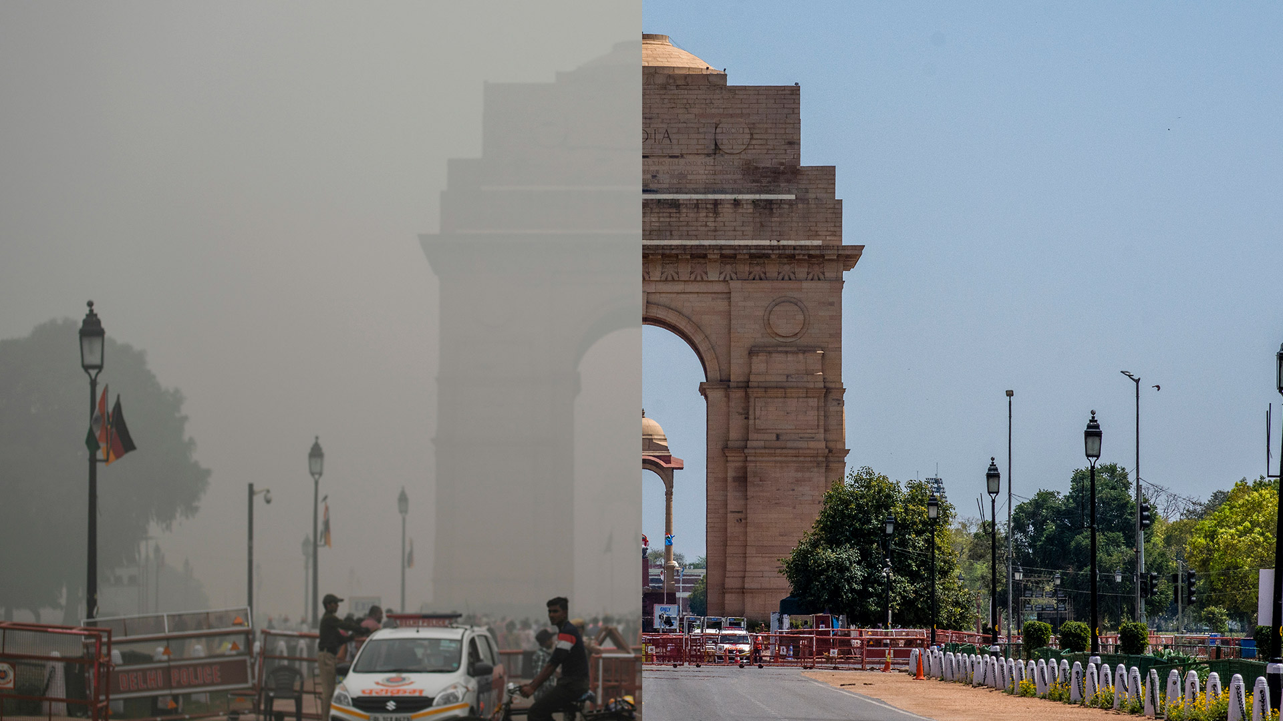
Finding#1
India is one of the countries with the worst ratings for Air Quality
9 of the Top 10 Cities in the world with the worst ratngs are in India
40.7% of its cities fall under the “Unhealthy” category
Multiple cities in India have AQI values of 500 which means they have “Hazardous” Air Quality conditions
Despite these findings, there are a couple of cities with “Good” ratings with AQI values under 50 such as:
Port Blair which is an Island far from the mainland
Chengam
Hindupur

Slide 10
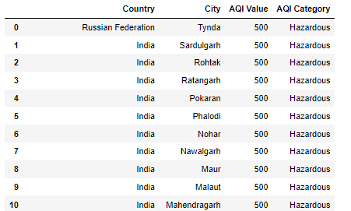
Top 10 Cities with the worst AQI values in the world

Slide 11
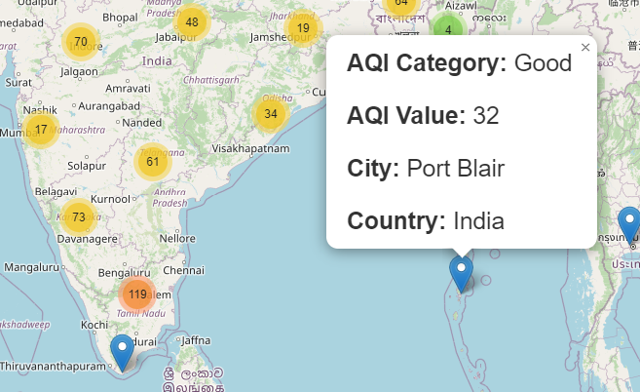
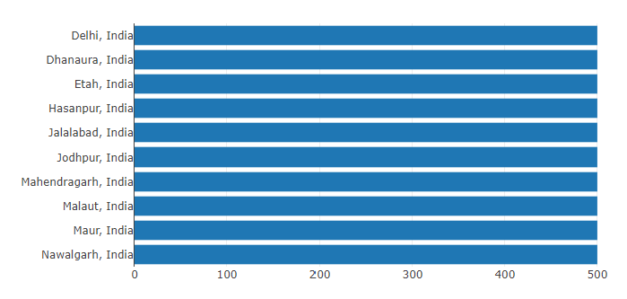
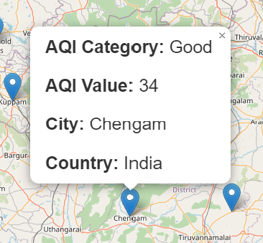
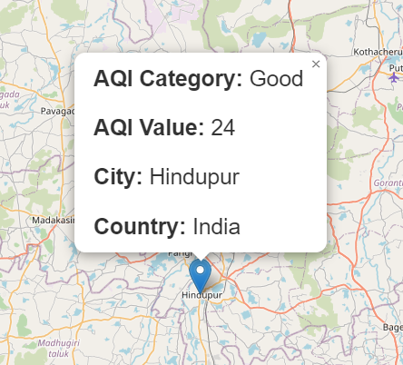
India’s Good and Bad Air Quality Cities
Good
Bad

Slide 12

Finding#2 Dallas Air Quality
Downtown Dallas has a moderate Air Quality Index value of 70
Celina,TX which is only 50 miles north of downtown Dallas has a much lower AQI value of 39 which makes it fall under the “Good” Air Quality category
This shows how AQI values are higher in bigger cities compared to more rural areas

Slide 13
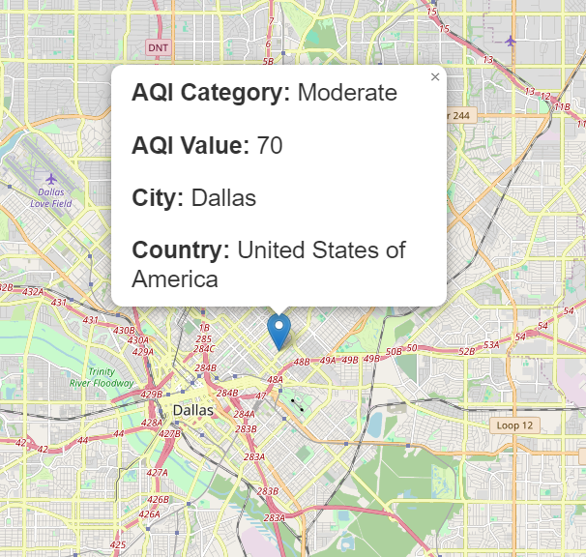

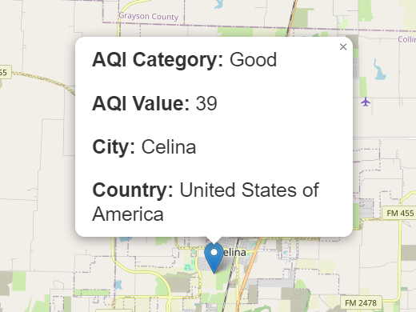

Slide 14
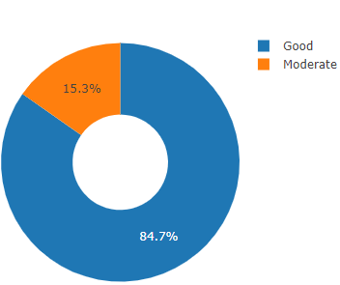
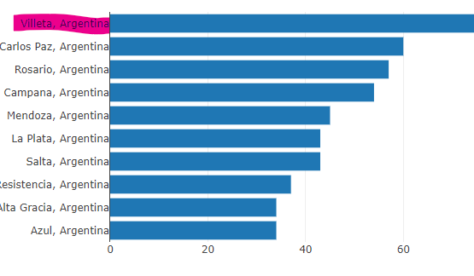
Finding#3 Argentina
84.7% of Cities in Argentina fall under the “Good” Air Quality Category
The City with the worst AQI value rating is Villeta which has a rating of 90 (Moderate Air Quality)

Slide 15
Finding#4

Slide 16
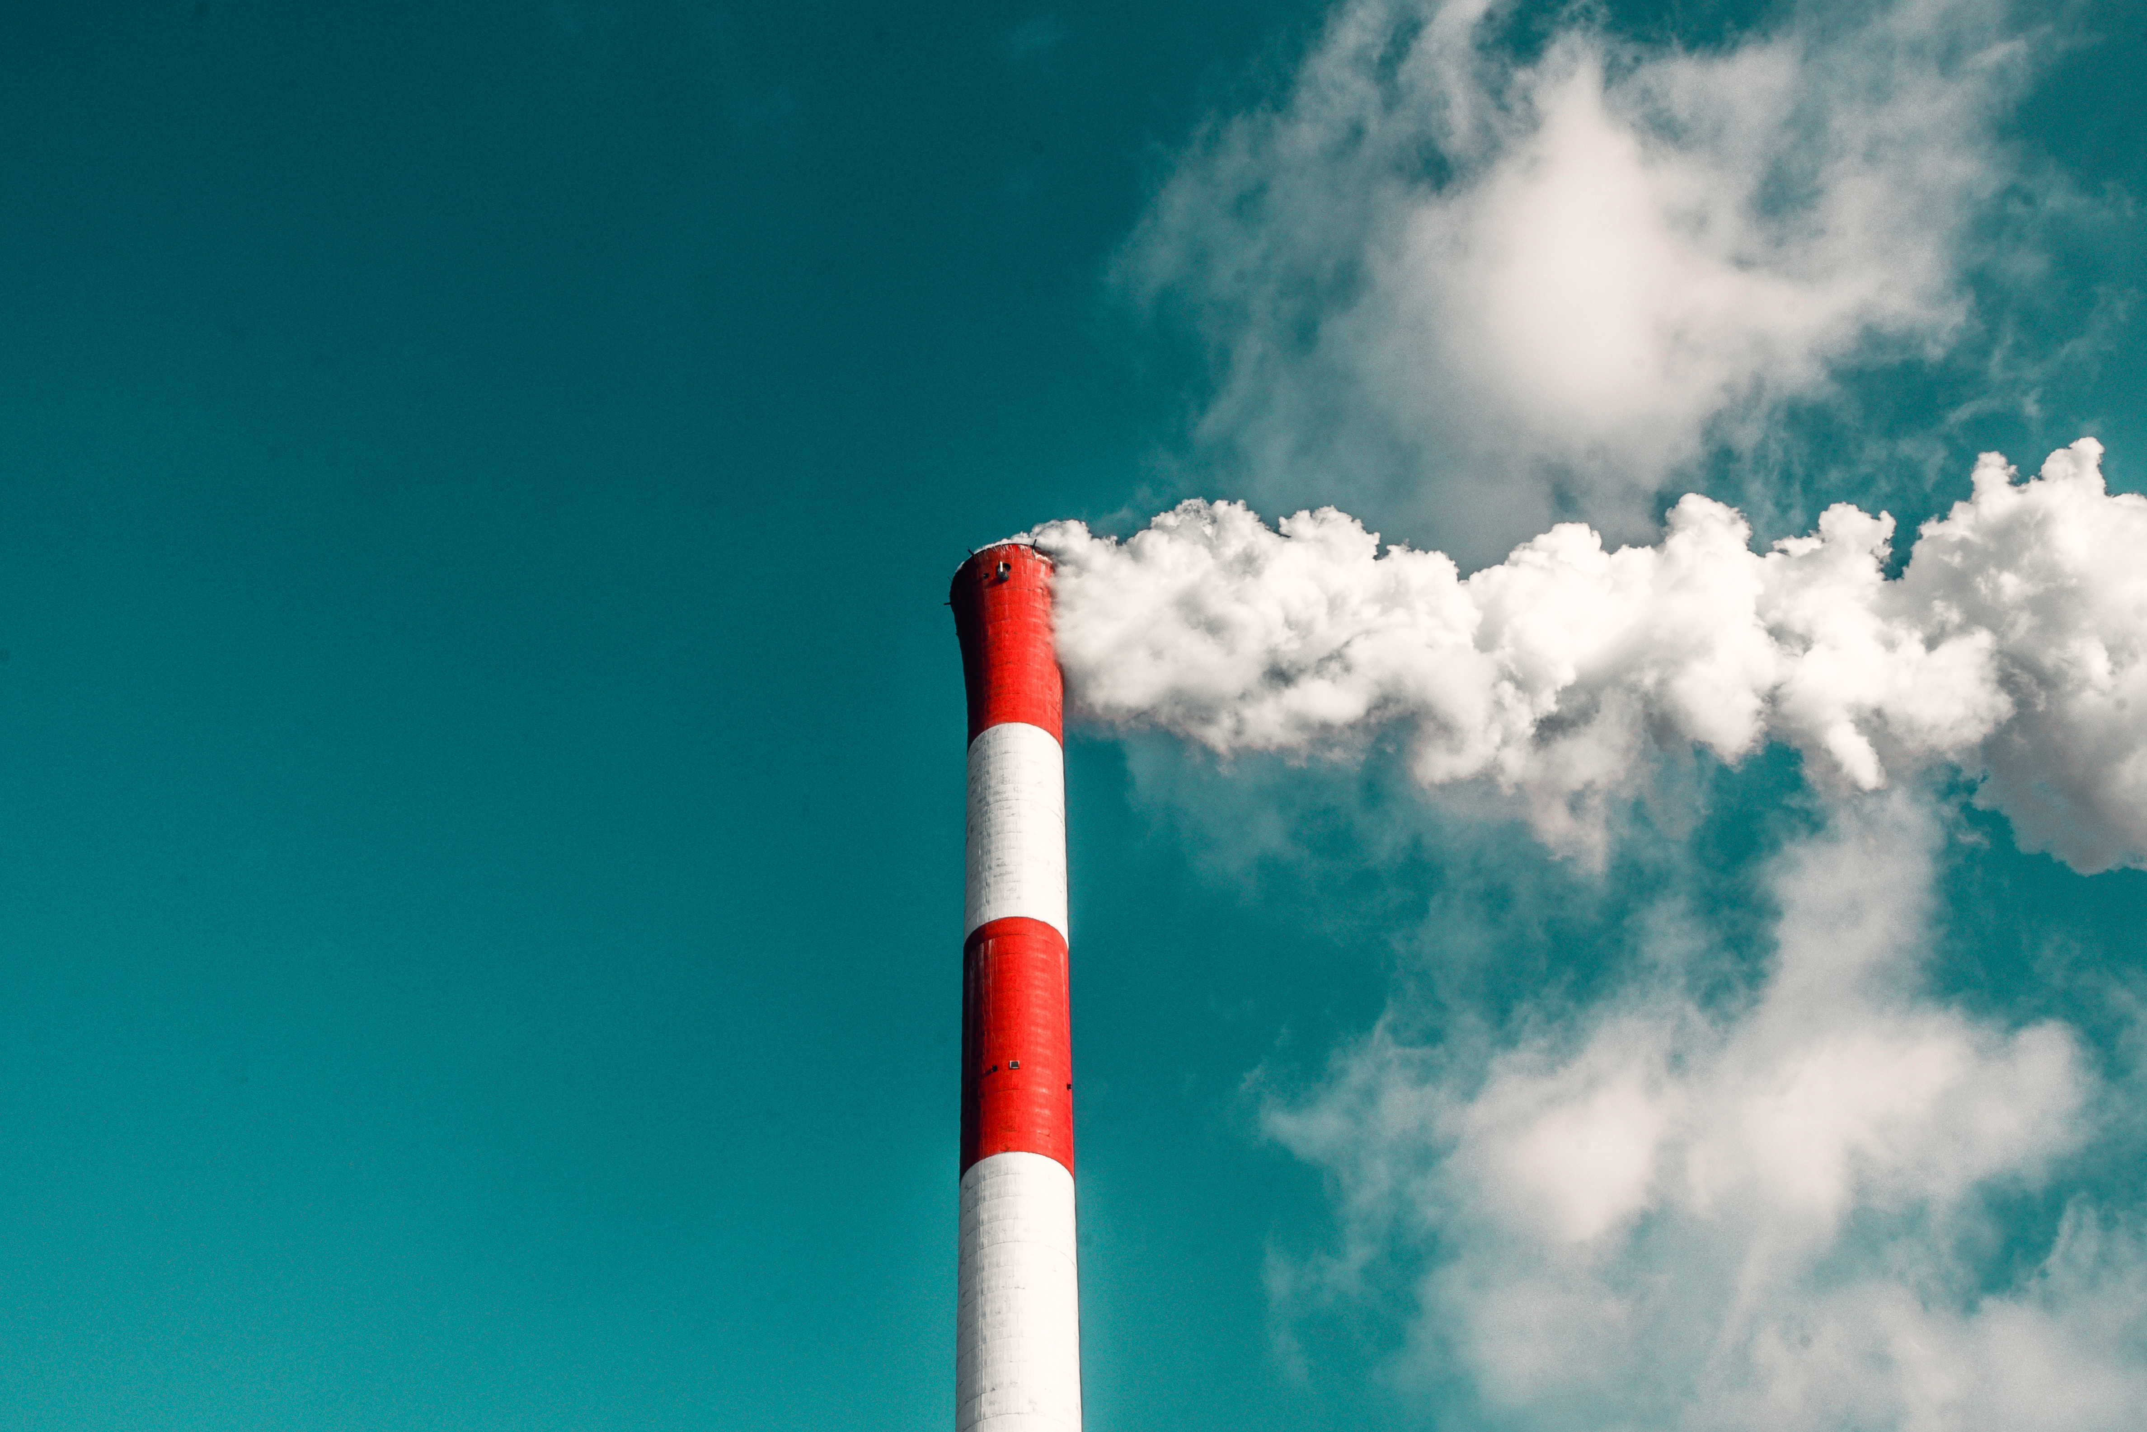
Conclusions

Slide 17

Limitations/Bias
Not all air quality pollutants are included in this data set such as Sulfur dioxide (SO₂)
There is no date/time information therefore it is unsure if the readings are all coming from the same point in time or throughout different dates
Some Cities have multiple entries while others have single ones. A more accurate analysis could be made if all locations got the same count of readings done on the same date.

Slide 18

Future Work
Can AQI readings fluctuate during the same day?
Does temperature have an effect of AQI values?
What age range is more sensitive to bad Air Quality?
Which Country has been the most successful in improving their overall air quality?
What industries are being more proactive in implementing solutions?

Slide 19

Image Links
https://www.news-medical.net/news/20230822/Can-air-pollution-shape-adolescent-brain-development-New-study-reveals-sex-specific-effects-of-PM25-NO2-and-O3-on-white-matter-microstructure.aspx
https://medium.com/mobile-development-group/lookout-air-quality-index-app-a59885eec085
https://www.lgnewsroom.com/2023/10/analyzing-and-managing-air-pollutants-to-create-better-life-for-all/
https://www.latimes.com/california/newsletter/2023-04-20/air-pollution-2023-essential-california-essential-california
https://genv.org/causes-of-air-pollution/
https://www.thelandofem.com/blog/2022/3/30/tox-in-the-land-carbon-monoxide
https://www.uia-initiative.eu/en/air-quality

Slide 20
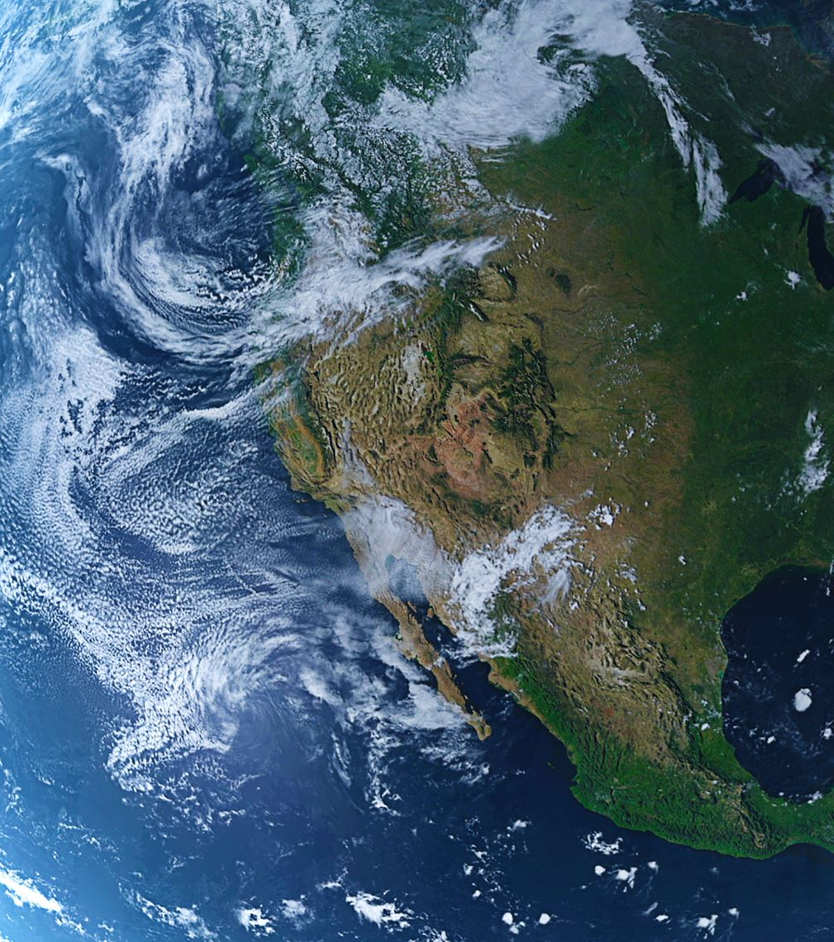
Article Links
https://www.weforum.org/agenda/2020/09/we-can-put-a-price-on-clean-air/
https://digitalprojects.davidson.edu/earthday2020/air-pollution/
https://www.deq.ok.gov/air-quality-division/ambient-monitoring/aqi-alerts-advisories/
https://www.who.int/news-room/fact-sheets/detail/ambient-(outdoor)-air-quality-and-health

Slide 21

https://www.kaggle.com/datasets/adityaramachandran27/world-air-quality-index-by-city-and-coordinates

